Slide 1

Financial Overview of Adventure Works Company

Slide 2
Today we will go through:
Relevant KPI’s
Sales
Sales/Countries
Types of Sales
Special Offers
Strategic insights for future growth

Slide 3
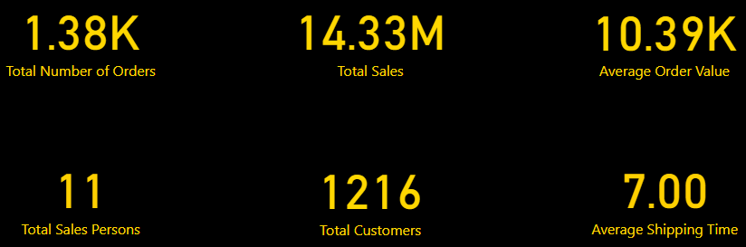
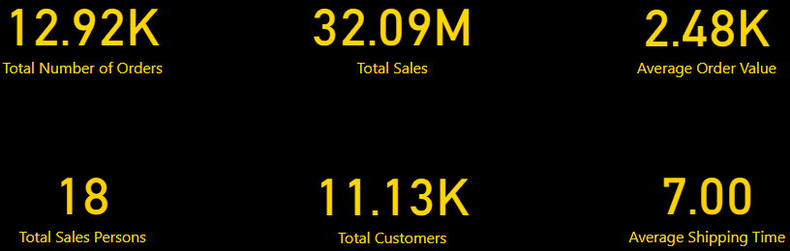
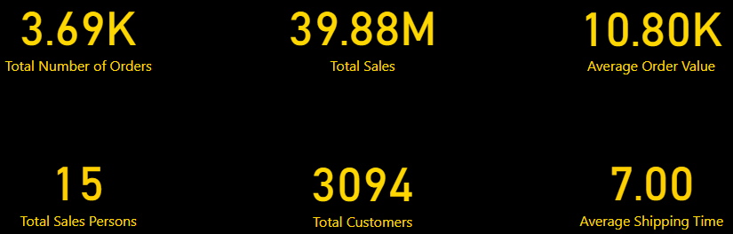
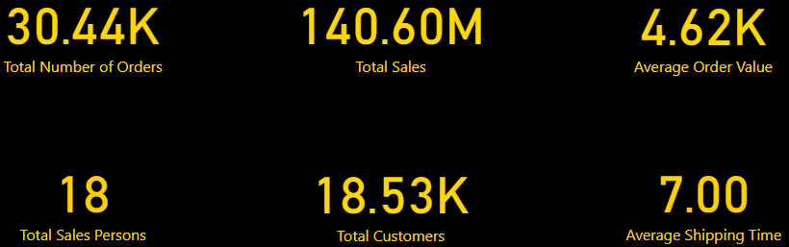
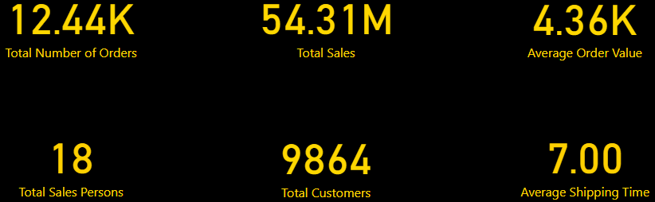
2003
2004
Total
KPI’s
2001
2002
2003
2004
2001
2002

Slide 4
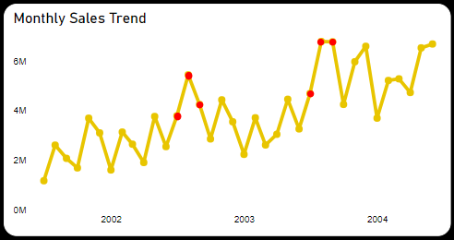
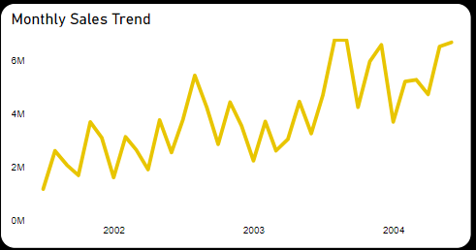
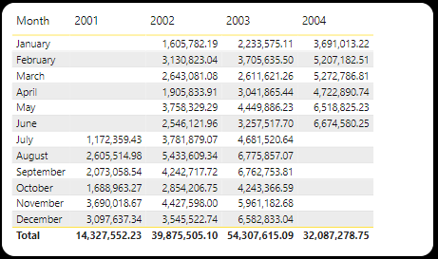
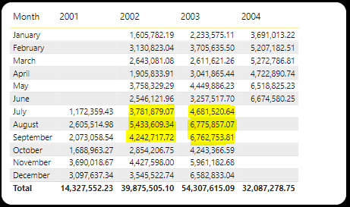
Sales
Sales trends are on the rise.
Roughly 36.2% increase per year.
Best selling periods are July - September.
Sales forecast for 2004 is 74 M.

Slide 5
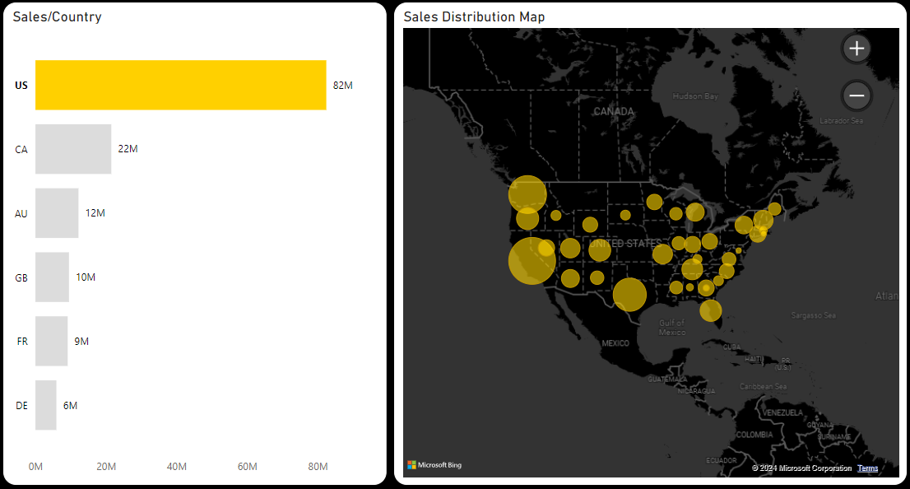
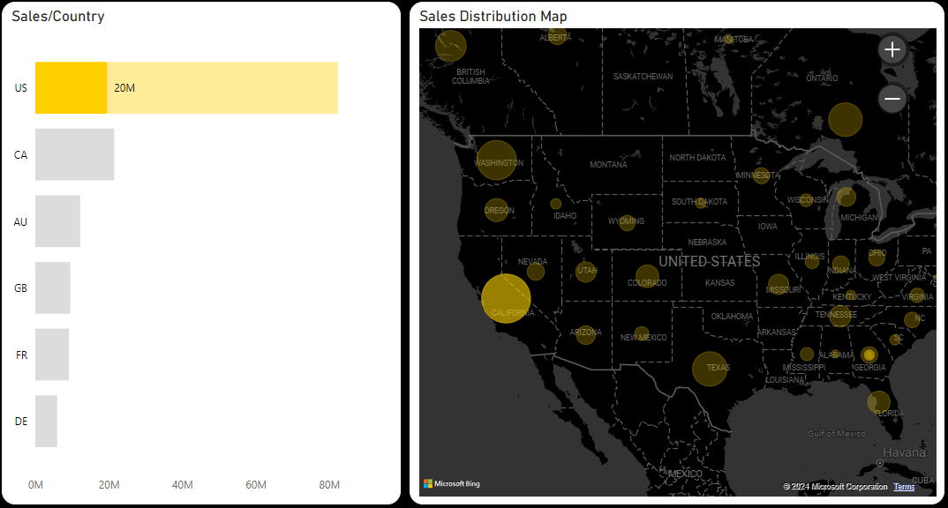
`
Sales/Countries
Best performing Country – US.
Roughly 58.6% of the market.
Best performing state – California.
Roughly 18.6% of US sales.
Europe still needs some time…

Slide 6
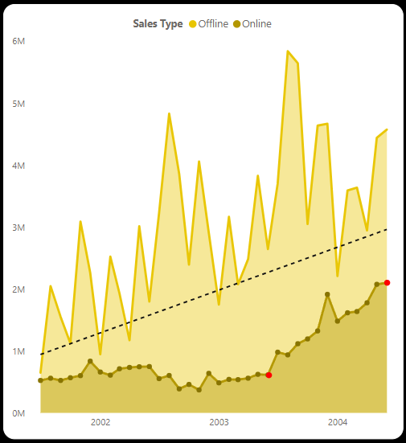
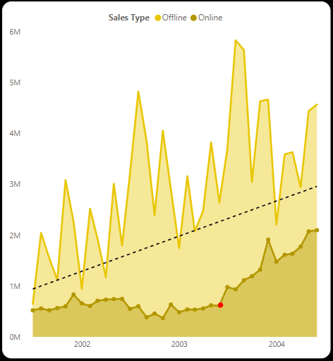
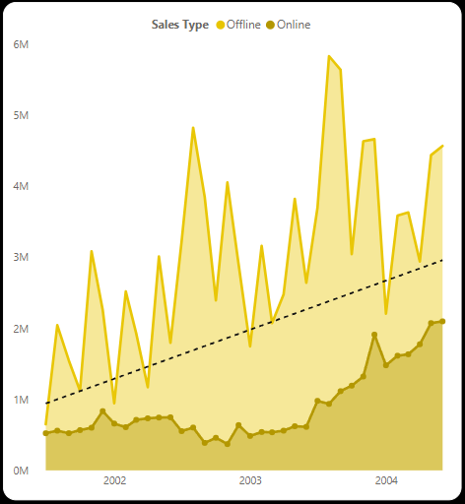
Types of Sales
Offline sales account for ≈77% of total sales.
Boom in Online sales since 2003 June.
In one year, Online sales increased 3.5-fold.

Slide 7
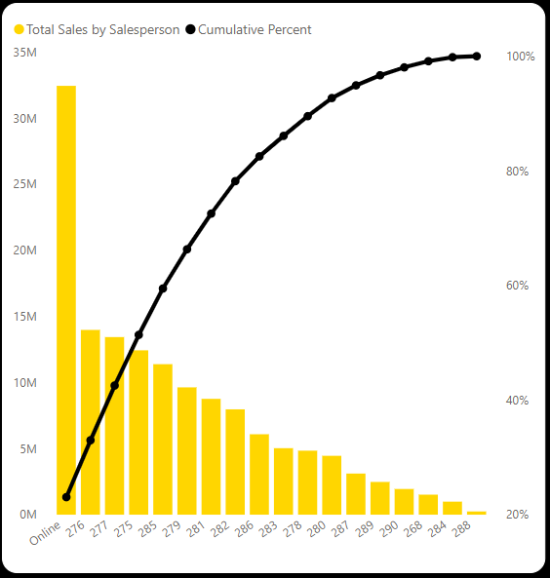
Top Salespersons
Top performing sales person - Linda Mitchell (276).
It takes ≈3 salespeople to match online sales value.

Slide 8
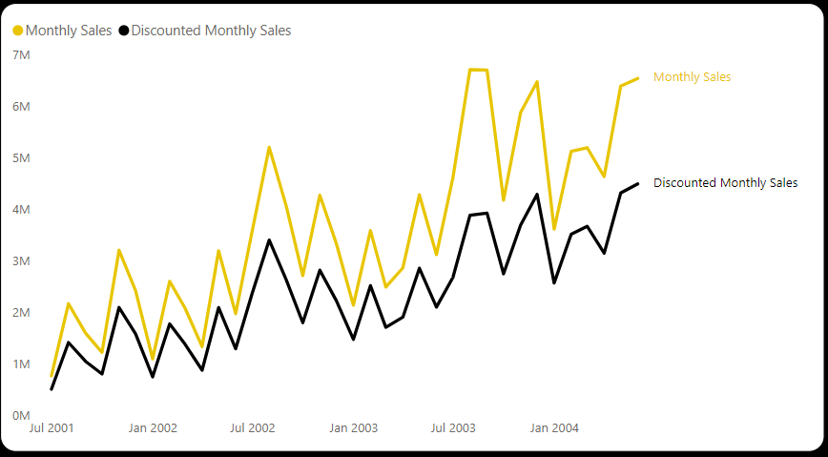
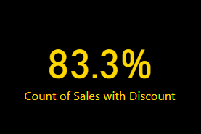
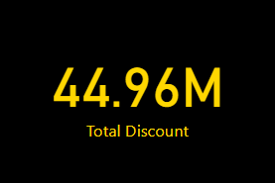
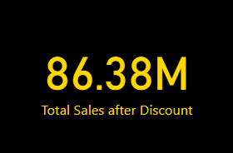
Special Offers
83% percent of sales were discounted items.
Discount values range between 500k and 3M.
Sales suffer a 38.6% decrease.
Do we scrap Discounts?

Slide 9
What should we do in the Future?
Implement measures to strengthen our online sales.
Investigate the EU market with a strategic focus.
Advertise more during the July - September period.
Optimize the discount policy for better results.
Leverage our past successes to continue our growth trajectory.

Slide 10
Questions?

Slide 11
Thank You!

